Slide 1
Capstone Project. The Battle of the Neighborhoods
Toronto and York

Slide 2
Toronto vs York. Where to eat better?
Eventually, at some point in life, we must leave behind the place we have lived in for years, for a job change, looking for better opportunities, or simply to gain new experiences.
There are many elements that we must consider in order to decide about the place we will choose to live the next stage of our life. Since, in general, people change their home to live there for a long time, the resources available in the new home must be analyzed in depth, since the quality of life, that they have, will largely depend on it.
One of the points that must be considered is food, so in this analysis we will focus on distinguishing which city has the best places to eat. The cities considered are those that contain the words Toronto (Downtown Toronto, East Toronto, West Toronto, Central Toronto) and York (North York, East York, York), we will treat each group as a different city.

Slide 3
Data acquisition and cleaning
We will use the data provided by Wikipedia to obtain the postal code of each city mentioned, we will unify the cities to have only two at the end (Toronto and York).
We will use the latitude and longitude data to print each location on a map.
Then we will use the Foursquare API to obtain the ratings of the restaurant category to finally obtain an average rating for each city and thus be able to select the best one.
Ignore cells with a borough that is Not assigned.
More than one neighborhood can exist in one postal code area.

Slide 4
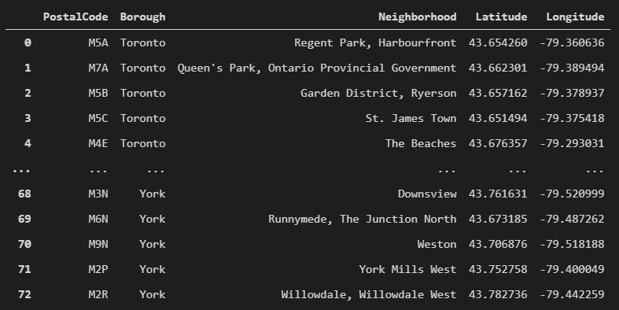
Complete dataset with the Latitude and Longitude values for each Neighborhood.

Slide 5
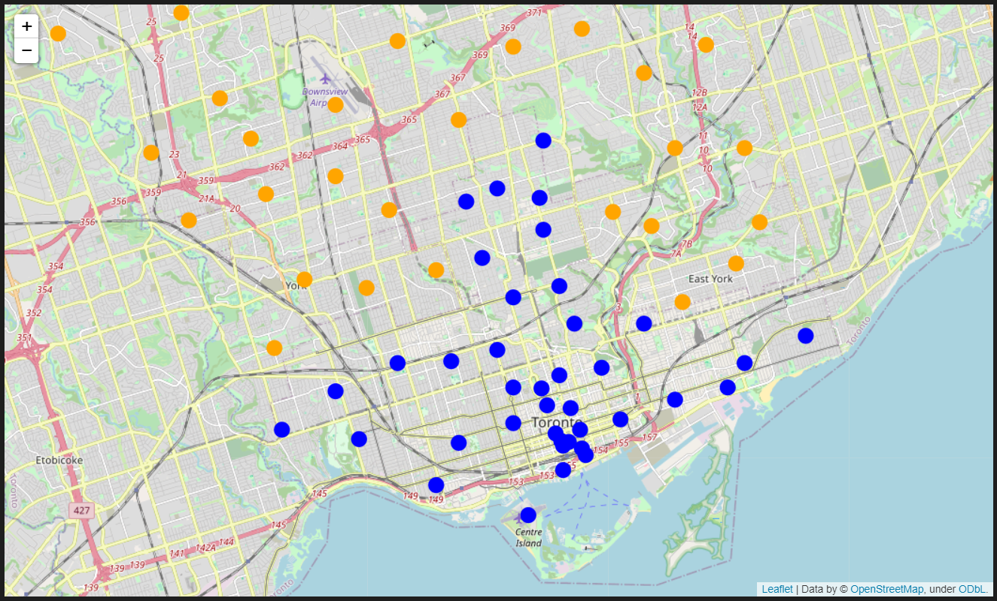
Map is more populated with Toronto (blue) venues than York (orange).

Slide 6
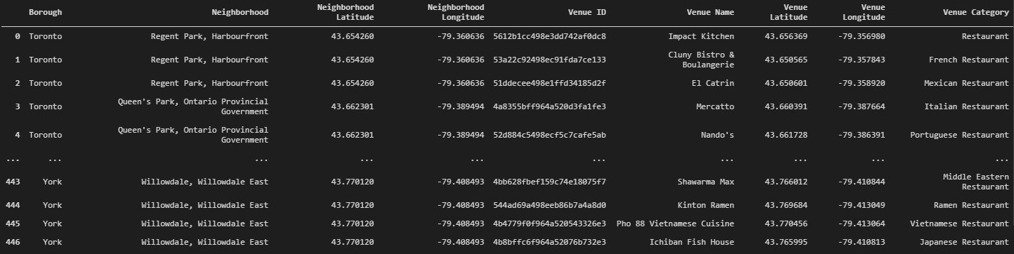
Get only the Restaurant category from the data.

Slide 7
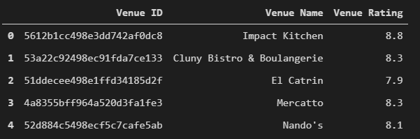
Use a function to get the rating for each restaurant in the dataset. This function uses a Premium call of Foursquare.

Slide 8
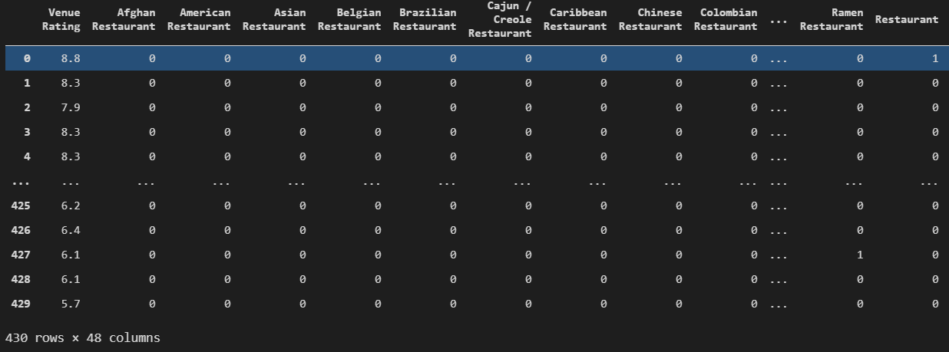
We will select 'Venue Category' and 'Venue Rating' as features to put in the Kmeans algorithm to create two clusters, which will indicate if each restaurant is in the most rated group or not.

Slide 9
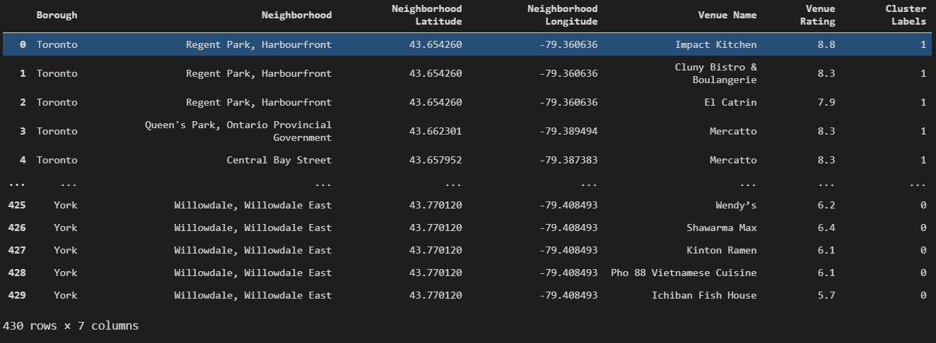
Data frame with the principal features and its labels.

Slide 10
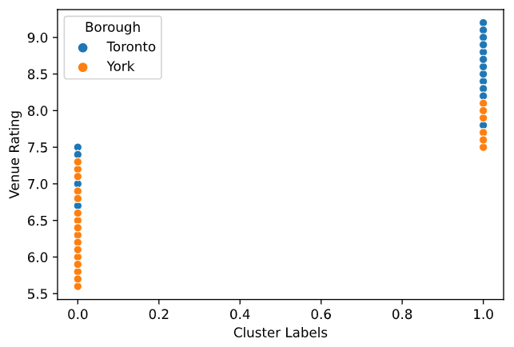
The clusters were divided about the 7.5 rating value.

Slide 11
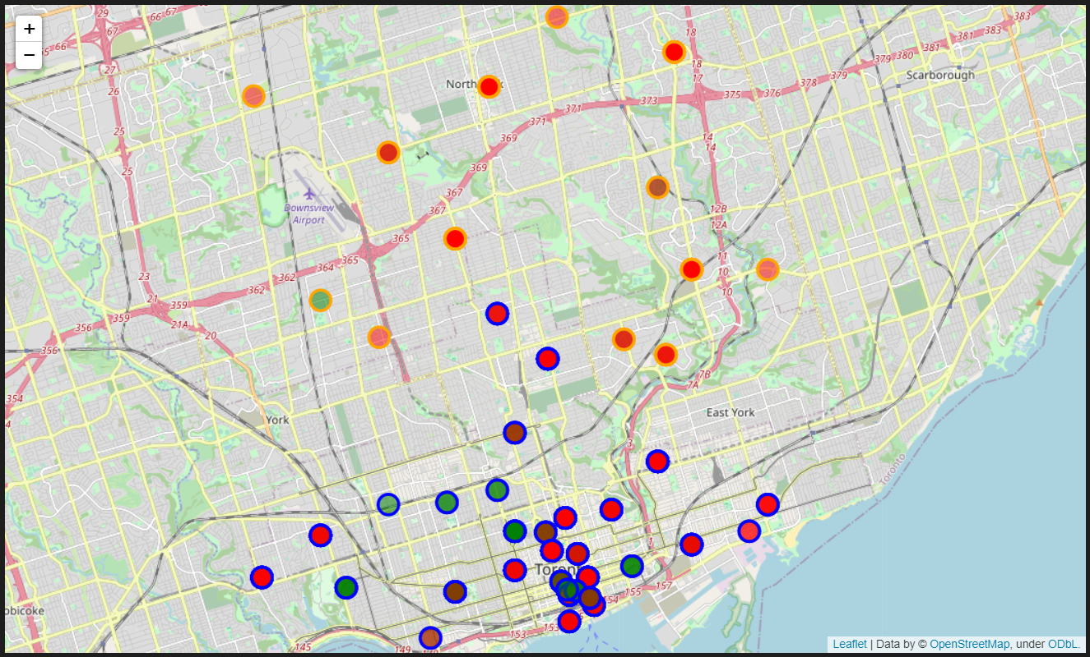
In next map, restaurants of Toronto (blue perimeter) and York (perimeter) are marked with green and red fills. Green corresponds to group with rating greater than 7.5 and red fill to restaurants with rating less than 7.5. We can see that most approved restaurants are in Toronto.

Slide 12
Conclusion
If you need to choose a Borough to live, Toronto o York, maybe Toronto is the best option for you because you can find the best and most varied restaurants in the region. People say through their ratings that in Toronto are the best restaurants that you can find in that region.

